Slide 1
Shrink Forecasting Using Deep Learning Methodologies
May Update 2021

Slide 2
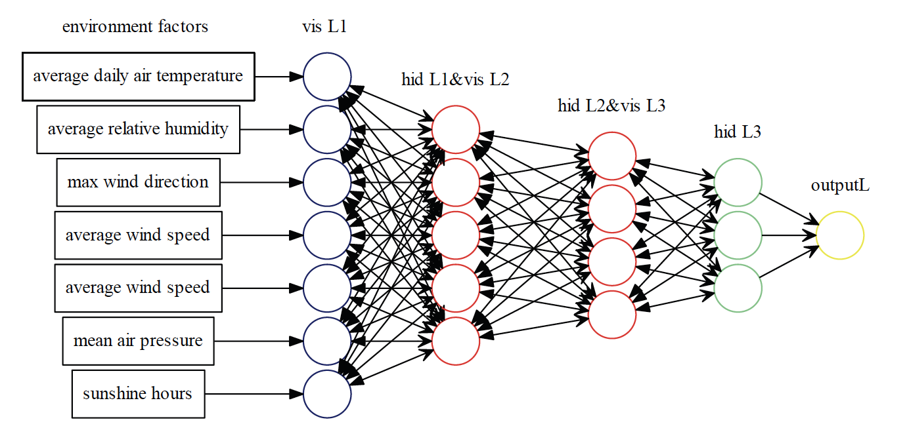
Recommended Approach
Identifying the most important variables to forecast
Solve Time Series Problem utilizing deep learning
Forecast out by week 12-24 weeks out
Shrink Factors
Economic Indicators
Shrink Rate
FET, LU, Location
HR, Terms, Tenure
Competition
CS/RNN/BOPIS
Clearance, Turns
Notes:
Average Tenure, Quick Term, Average Wage, PT Ratio,

Slide 3
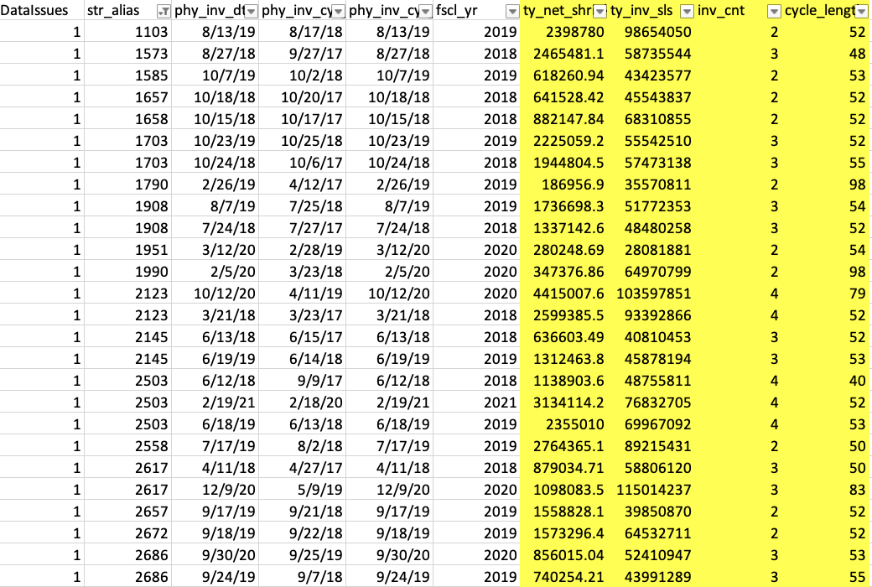
Potential Data Drops

Slide 4
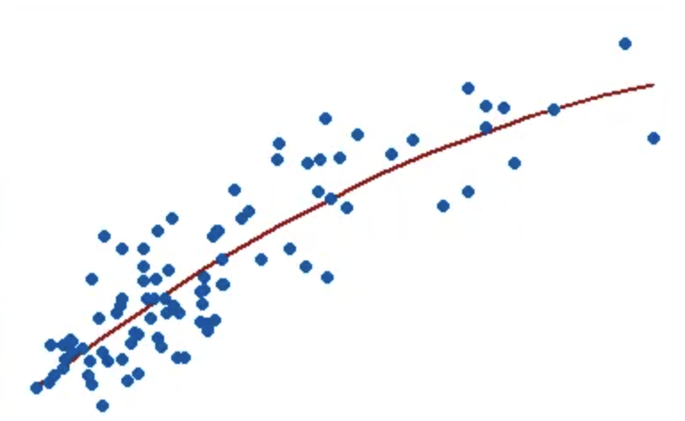
Background
Home Depot relies on a modeling framework that predicts shrink on an ongoing basis using the most current data. However, this leaves stores without knowledge of what may happen between today and the 3, 6, or 9 months leading up to the inventory.
By extending the current model into a forecast, or by using other modeling methods to anticipate future trends, it will be possible to understand how past data trends will translate into total shrink at the end of an inventory.
Identify the most important variables to forecast, and creating a powerful forecast engine, presents a vast and highly complex problem that an AI driven model can help to answer.
Currently using a regression model
Notes:
At a high level, we want to use a hybrid CNN-LSTM architecture, in which a CNN layer is used to embed the many features we have in our dataset, followed by an LSTM layer to handle the time-series processing and output a shrink forecast. The reasoning behind this is that LSTMs have trouble outputting forecasts due to the heterogeneity of features, but we can use the initial CNN layer to embed these features into matrices that the LSTM will better be able to handle.
Deep learning as a forecasting tool is a very recent development, but we think it bodes a lot of promise in generating accurate forecasts using feature-rich data such as the many shrink indicators and sales statistics. We will also add socioeconomic data such as unemployment rate by zip code as features, which the CNN would be able to embed as part of a matrix representation.

Slide 5
Appendix:
Reference papers:
https://arxiv.org/pdf/2001.08317.pdf
https://openreview.net/pdf?id=HJJ0w--0W
https://www.researchgate.net/publication/319633104_A_Deep-Learning_Based_Precipitation_Forecasting_Approach_Using_Multiple_Environmental_Factors
https://www.researchgate.net/publication/320597233_Wider_and_Deeper_Cheaper_and_Faster_Tensorized_LSTMs_for_Sequence_Learning/figures?lo=1
UBER: https://arxiv.org/pdf/1709.01907.pdf
Reference tools:
https://venturebeat.com/2021/05/13/linkedin-open-sources-greykite-a-library-for-time-series-forecasting/
Reference books:
https://d2l.ai/chapter_recurrent-modern/deep-rnn.html

Slide 6
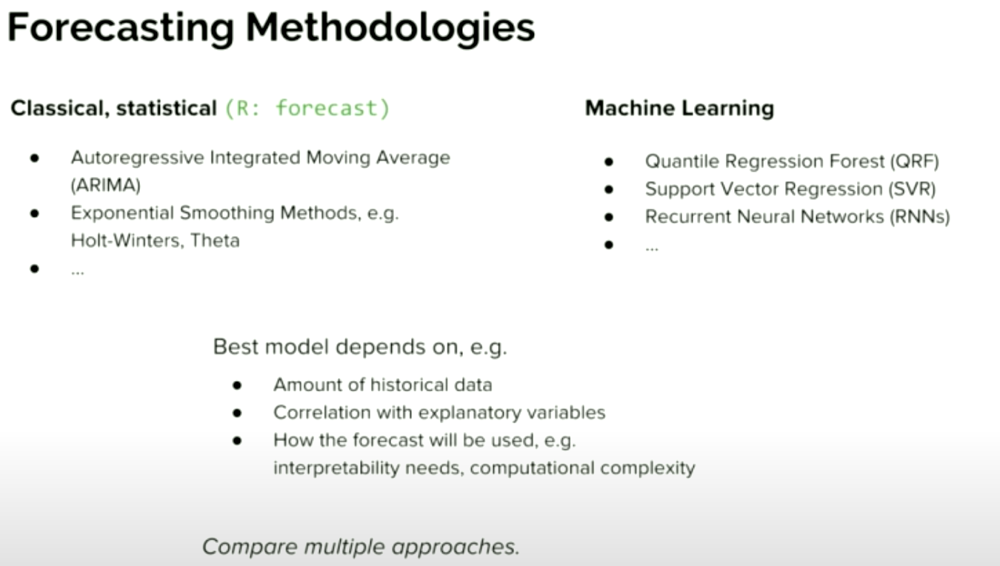
Appendix:

Slide 7
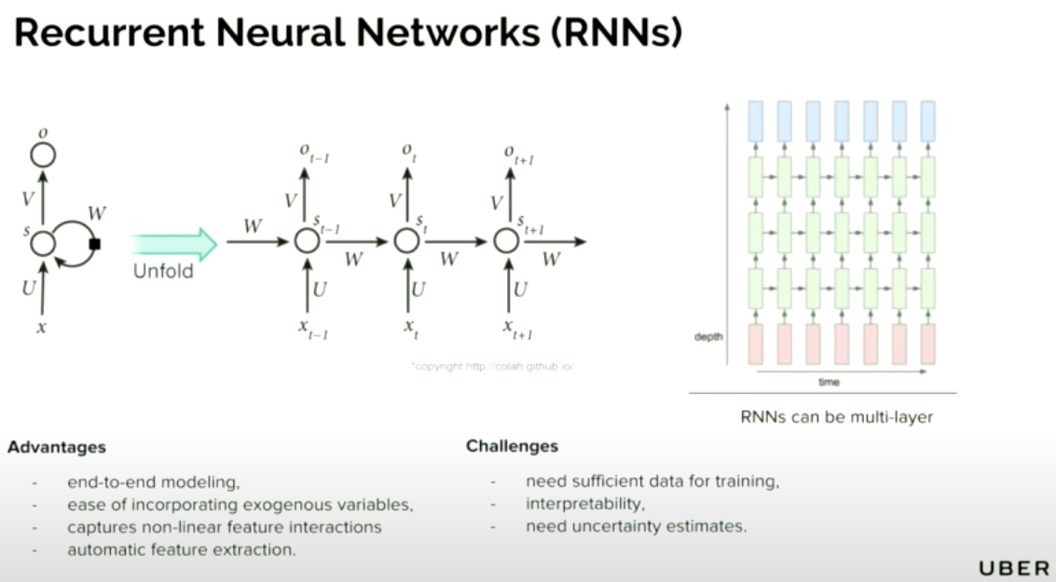

Slide 8
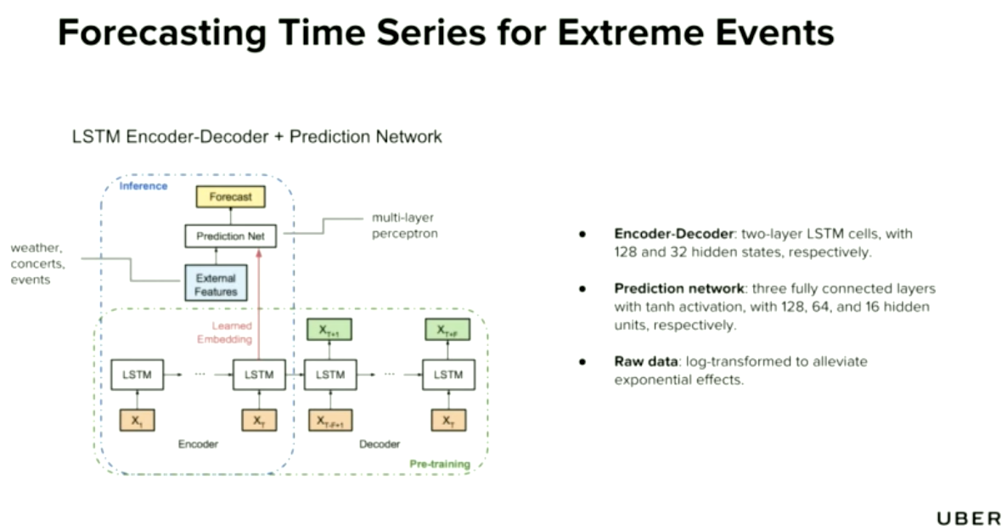

Slide 9
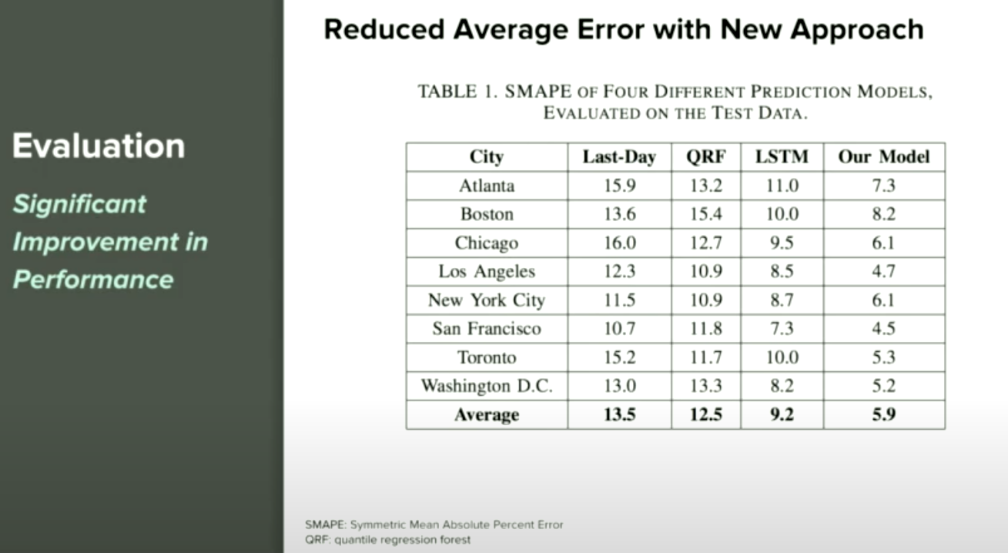

Slide 10
